Slide 1
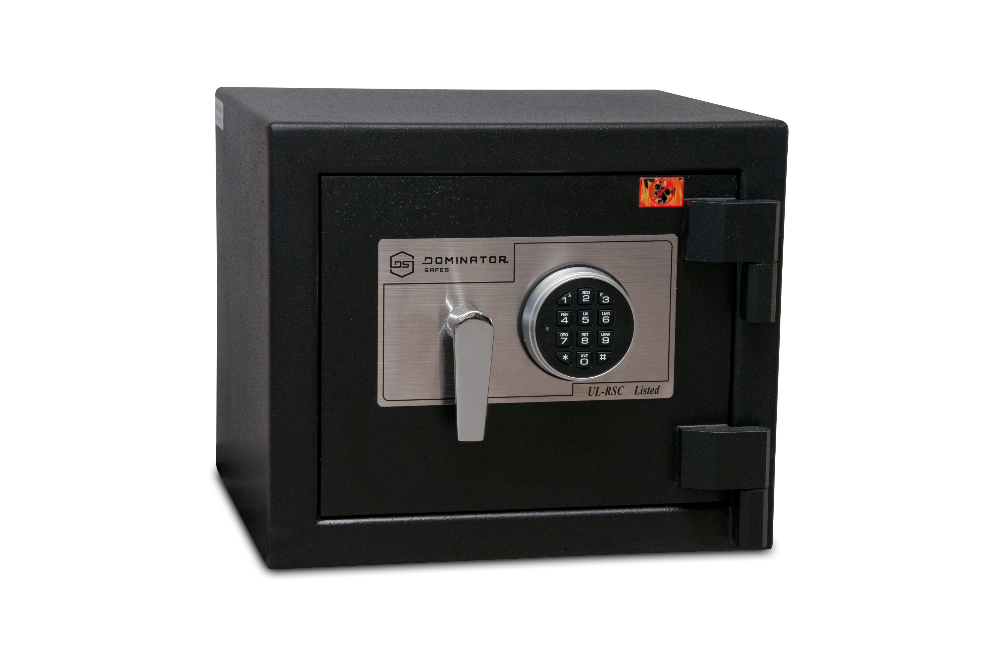

Slide 2
















Slide 3
PassGen
Maharashtra Institute of Technology,
Aurangabad
Team Members:
Roman Kazi
Tejas Devda
Mayuresh Khemnar
Sankalp Pol
Aniket Giri
Ninad Dere
Mentor:
Mr. Nihit Agrawal

Slide 4
Abstract
In today's world we have an account for approximately every site we visit making it very hard to remember passwords for each and every site, in such case the user generally approaches with two options first he/she use the same password for every account or secondly he/she uses different password for different sites but which are easier to remember, both this approaches are dangerous and presents an attack vector for the bad actors.

Slide 5
Here are some interesting facts about passwords
0.5% of users have the password password;
0.9% have the passwords password, 123456 or 12345678;
4.4% have a password from the top 100 passwords
13.2% have a password from the top 1,000 passwords
30% have a password from the top 10,000 passwords
Source: Internet

Slide 6
PassGen solves this two problems by reducing all those passwords with just one master password and by providing strong and unique passwords for every account.
The user have access to all their account credentials via an android app which requires login using the master password, once the user is successfully logged-in he/she can add, view, update or delete their password credentials through a user-friendly interface.
PassGen stores the user credentials in a secure encrypted local database. Helping users focus on what’s important and leave remembering passwords to PassGen.

Slide 7
Technology Stack
Android Platform | Web Development
Java | PHP
XML | Javascript & AJAX
Database | Database Language
MySQL(Web) | SQL
SQLite(Android) | SQL
Tools Used
Android Studio

Slide 8
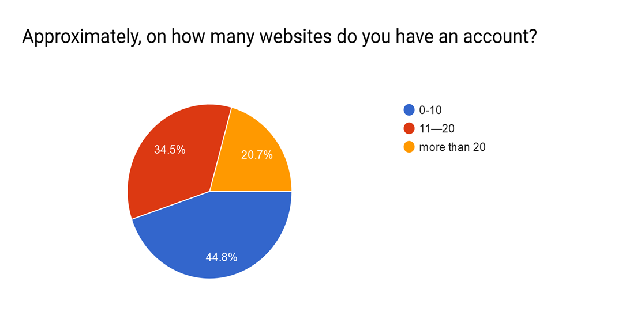
Survey

Slide 9
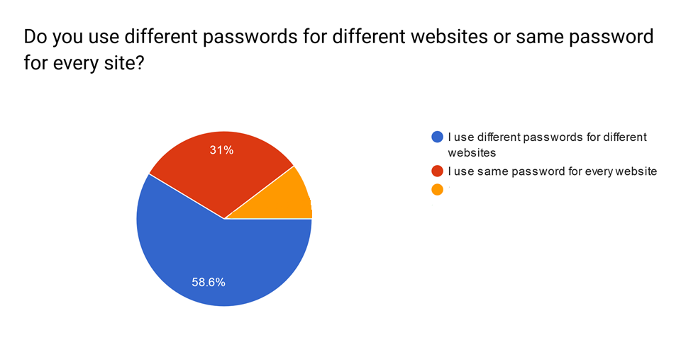
Survey
Other
10.4%

Slide 10








Authentication Successful
Functionalities
PASSWORD
A9k@s^3^#$&%^#@/#*$14+
Encryption
Master Password Authentication
Add
s^aw!$%v3@/#*$6+
New PASSWORD
Authentication Failed
Encryption
Main Login Page
Local Encrypted Database
Update
A9k@s^3^#$&%^#@/#*$14+
PASSWORD
Decrypt
Search
X-X-X-X-X-X-X-X-X-X-X
PassGen
Delete

Slide 11
Thank You

